Slide 1
Neuroconnect:
A Final Digital Marketing Plan
Team 2: Brandox Fox, Lindsey Giorgi, Liangyu Liu, and Kushal Shah
Notes:
BF
Hi everyone! Welcome to our final presentation on our company idea of Neuroconnect. We are team two and we will introduce ourselves by going down the line here so starting my name is Brandon (continue names), so now let’s just right into it!

Slide 2
Outline
1
Background and Company Story
2
Business Model and Strategy
3
Differentiators
4
Marketing Strategy
5
Positioning and Core Messaging
6
Communication and Promotions Plan
7
Measuring Success
8
Questions
Notes:
BF
Here is a brief outline and agenda for the presentation today (describe each point briefly)

Slide 3
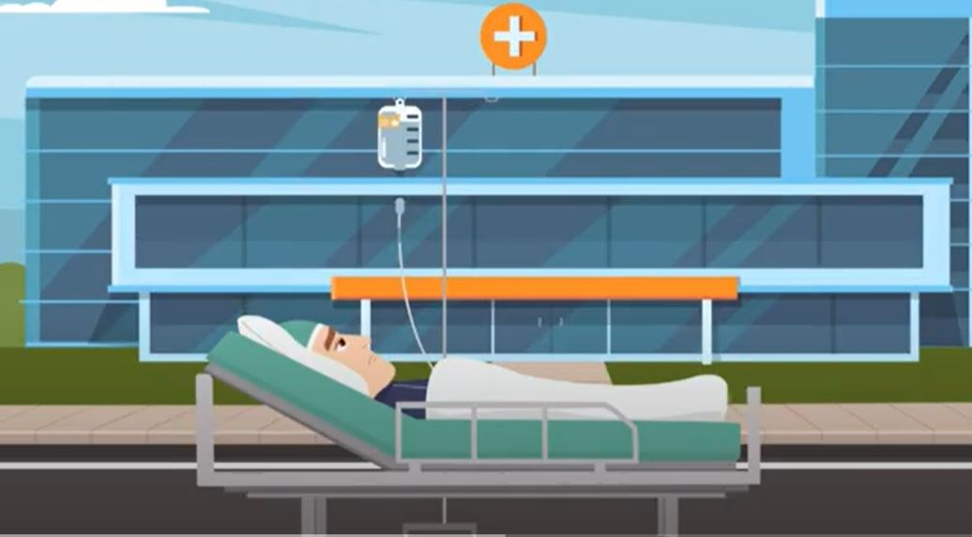

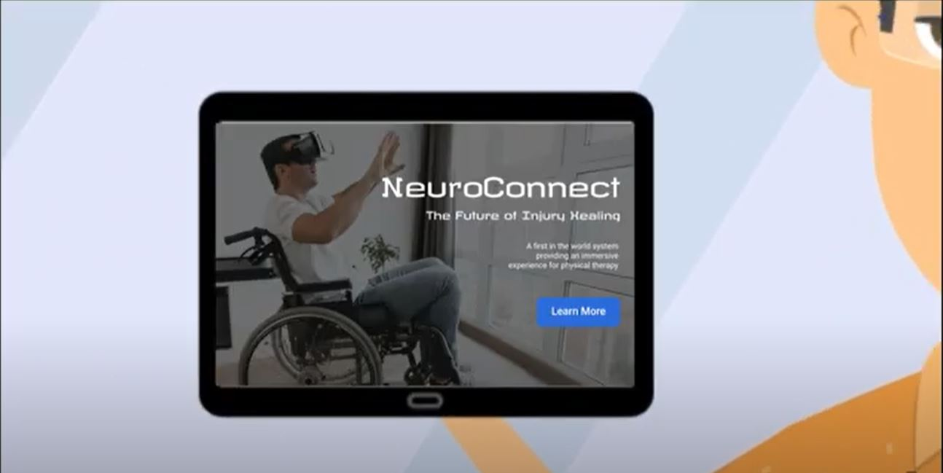
Background and Company Story
Mark and Lisa’s son was injured in a soccer game and was recommended to physical therapy
Mark wanted to go a different route and found Neuralink during research
Lisa, the physical therapist, and Mark worked with the new technology to create Neuroconnect
Notes:
BF
Whether it’s a scratch from falling off your bike at five years old or a major injury later in life, everyone has experienced pain. Recovery processes are different for every injury and every person and that’s why basic physical therapy is not always the best option. Neuroconnect gives each individual a personalized care plan to recover from injury and allows everyone to do it their own way to ensure the therapy is the best it can be. Built by loving and caring parents, this company was created from the dream that their son would be able to return to his passion: soccer. Combining the technology of virtual reality and physical therapy, Neuronconnect allows people to stretch, train, and recover at their own pace, on their own time, and their own way.
Because the company was built completely around the healing process, we are committed to the individual. The customized therapy allows working specific areas from the brain’s network. You do not need heavy equipment or a physical therapy gym or office to start recovering. The company’s mission involves nothing but offering the best care and help to individuals trying to recover and get back to doing what they love.

Slide 4
Business Model And Strategy
Target Markets
Business Model Canvas
Customer Value Proposition
Industry Analysis
Notes:
BF
Target markets: the main target market is athletes of all ages. Specifically, this would be very helpful for young athletes going into college level and professional as injuries tend to be a big setback during those crucial points in life. We will review the business model canvas in the next slide here but this will show the different stakeholders and supporters involved in this process.
Customer value proposition: these will be reviewed in the canvas but the main propositions include:
Fully integrated system without need for additional equipment
Ability to recover from injury or chronic pain wherever you go
Immersive VR experience without additional equipment required
Finally, the industry analysis covers porter’s five forces and mainly focuses on the aspects of virtual reality and BMI or Brain-Machine Integration which involves the neuralink chip.

Slide 5
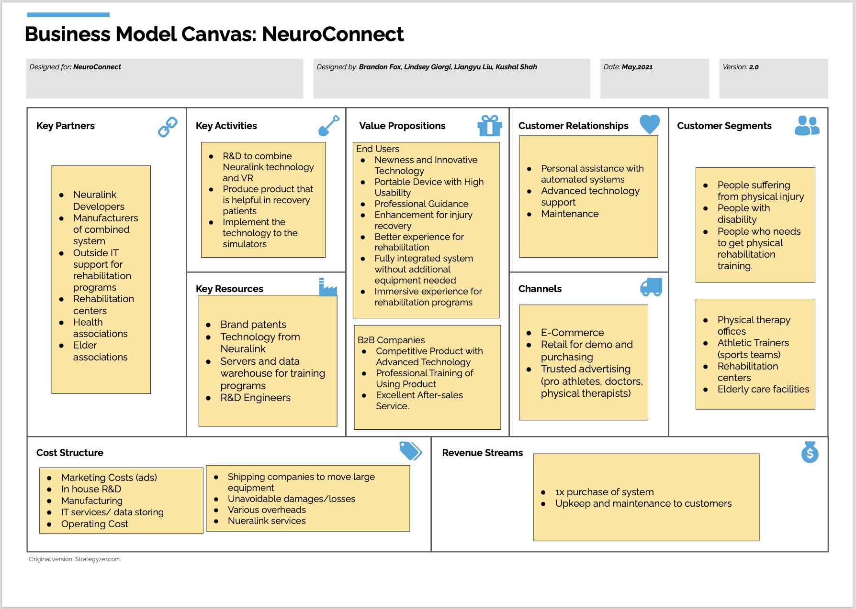
Notes:
BF
Quick overview of the business model canvas. Focus at this stage will lie mostly in the customer segments and value propositions

Slide 6
Competitor Analysis & Differentiators
-
Market size of non-invasive ~$1.2 billion and steadily growing
Competitors: BrainCo, Emotiv, and Kernel
BMI
-
Porter’s 5 Forces
Competitors: Intel, Google, Apple, and Oculus
Virtual Reality
Methods
-
Utilizing AI technology and VR frameworks designed specifically for injury recovery
Constant technology upgrades
First of its kind
-
Can do from wherever
No heavy equipment or machinery
Convenience and Ease
Notes:
Liangyu
BMI: BMI or Brain-machine integration is showing exponential growth from year-to-year and has resulted in a couple competitors including BrainCo, Emotiv, and Kernel which are trying to create a similar implantable chip as Neuralink where we would use the current technology
Virtual Reality: VR has been around for a long time now and is the main component of our porter five forces due to its strong establishment. The main rivalry occurs with the AI chips used for Virtual reality coming from Intel, Google, and Apple primarily, but large companies like Oculus who specialize in the technology would be a big supplier. Finally, the price of Neuroconnect would be estimated at the same price as LASIK eye surgery which would be $2,200 for implanting the chip. Further costs come with using the service.
First of its kind: This combination and vision of using this technology is brand new to the market. The two entities of VR and BMI are being combined for injury recovery aid and the technology will continue to see upgrades and updates due to its prevalence in many applications.
Convenience and Ease: The biggest value proposition is how convenient this device makes it to recover from injury wherever you go and whenever you can. The technology goes with you wherever you go and requires no additional equipment.
Linagyu

Slide 7
Marketing Strategy
Search Campaign
Positioning & Website
Communication Plan
Measuring Success
Notes:
Liangyu
After the business model and strategy had been formed and explained, and the industry analyzed, the team worked together to create a marketing plan specific for launching Neuroconnect. There are many different factors and perspectives that need to be considered while developing the marketing tools for the product. This section will provide insights on the marketing strategy and goals, positioning and core messaging, marketing content, communication and promotional activities, and how success will be measured.

Slide 8
For individuals recovering from injury, who want to experience a virtual reality simulation to play out real-life scenarios for recovery, Neuroconnect is a VR device that allows users to utilize virtual and augmented reality functionality without heavy equipment”
Notes:
Liangyu
This is the company’s positioning statement, a brief way of showing the target customer, customer need, market category, and key benefits. To expand upon this statement and show how the product is unique and different, we add, “Unlike current advancements including Neuralink and virtual reality headsets, NeuroConnect implements all the required elements for an immersive real-life experience to help simulate states for injury recovery. While VR has been used mostly for gaming in the past, the concept of Neuralink is relatively new. Neuralink connects your brain to the computers, thus enabling you to use VR to really feel your surroundings for an immersive experience.” The goal of these messages is to ensure that the customer knows the company and product after only a short read. The company uses these statements in creating all marketing materials to stay consistent and keep the vision clear.

Slide 9
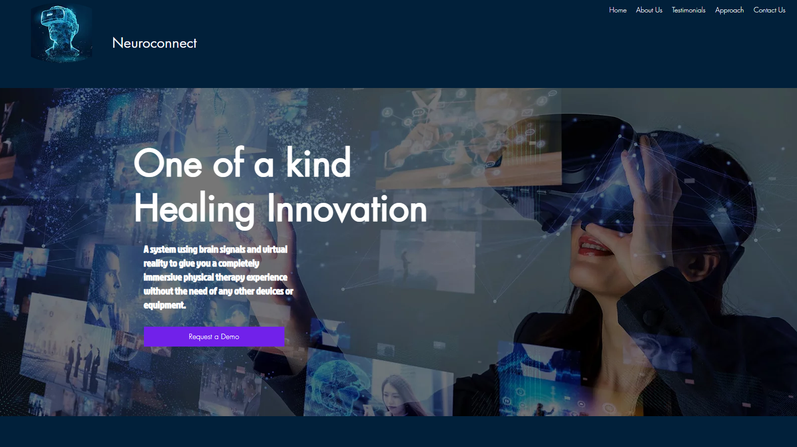
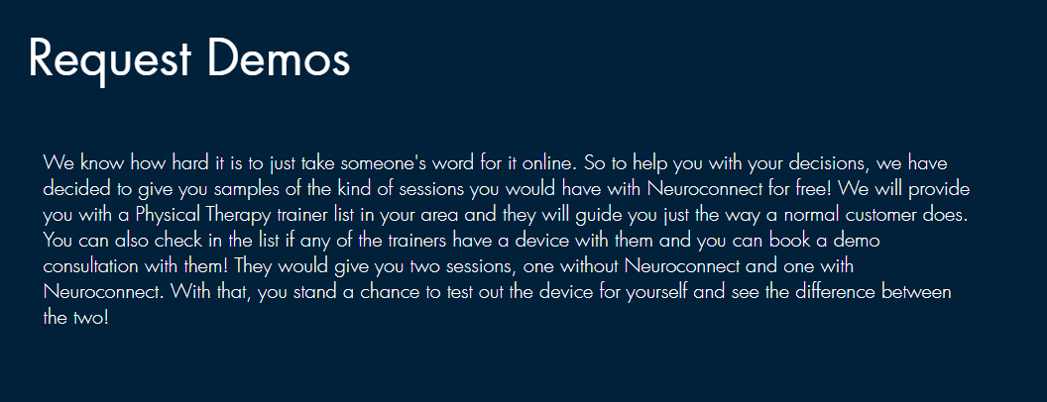
Website
01
Introduction
02
Request demo
Notes:
Liangyu

Slide 10
Communication & Promotion Plan
01
Search Engine Optimization
Text Ads
Keywords
Maximize ROI
Ad Placement
Search Marketing
02
Instagram, Facebook, Twitter, and Tiktok
Content Calendar
Social Media
Notes:
Lindsey
The team is using search marketing tactics to gain traffic and presence through search engines. The steps we will take to ensure successful SEO are crawl accessibility so different engines can reach our content, compelling content that is easy for customers to read, keywords optimized for attracting engines and searches, excellent user experience that includes fast loading speeds and ease of use, share-worthy content that creates opportunity with links, citations, and amplification, eye catching title, URL, and description to draw higher click-through rates, and snippet markups to stand out in search engine results pages. Once these had been created, we worked on an ad placement plan that shows how we intend to reach our target market through digital channels. The channels we will be utilizing are social media, search engine marketing, and display advertisements, and examples of each of these are in their respective appendices.
Social media is one of the easiest ways to reach potential customers, especially using professional athletes and nation-wide recognized physical therapists and athletic trainers to endorse the brand. We created a content calendar and examples of posts for different social media platforms. Increasing brand awareness, boosting sales, and driving traffic to our website is our main priority.

Slide 11
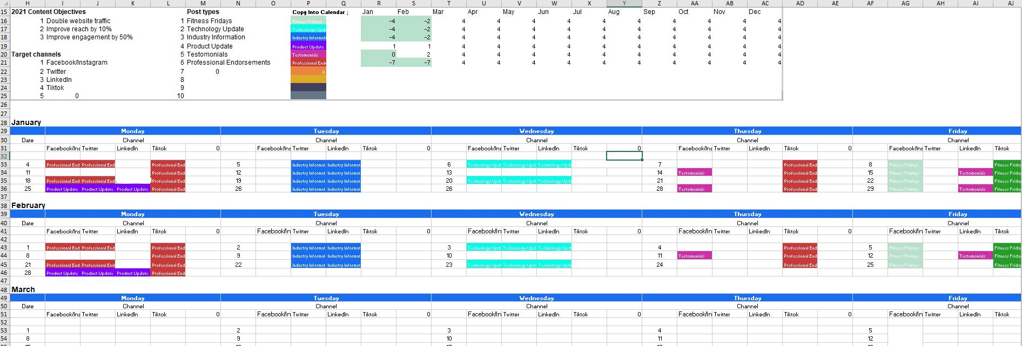
Notes:
Lindsey
Our content calendar shows our goals and strategies for our advertisement campaign. The calendar shows how advertisements are placed in different spots in different times to cover different channels, audiences, and maximize ROI. These are then measured and optimized to ensure the best performance through each channel.
This is small snippet of the content calendar we created. It shows two months of planned out media posts across different platforms. This spreadsheet used yearly content objectives, target channels, and post types through categorized colors to show when and where the company would like to post to achieve different marketing objectives. For example, the two different color greens on Friday show that a “Fitness Friday” post will be sent to TikTok and Facebook and Instagram featuring a celebrity endorsement.

Slide 12
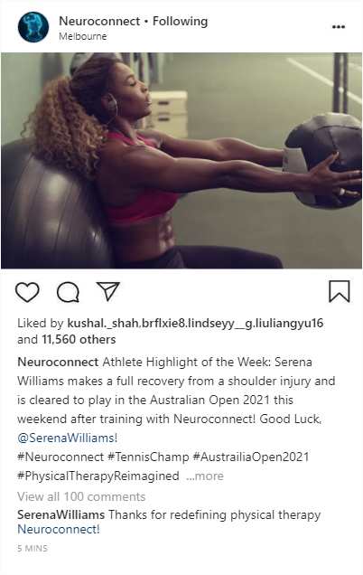

Instagram TikTok
Notes:
Lindsey
This is Fitness Friday post , like mentioned before, that would be posted to Instagram. It shows Serena Williams working out using Neuroconnect. We also created an example TikTok. These types of celebrity posts are good content for these kinds of platforms where the endorsers have large followings.

Slide 13
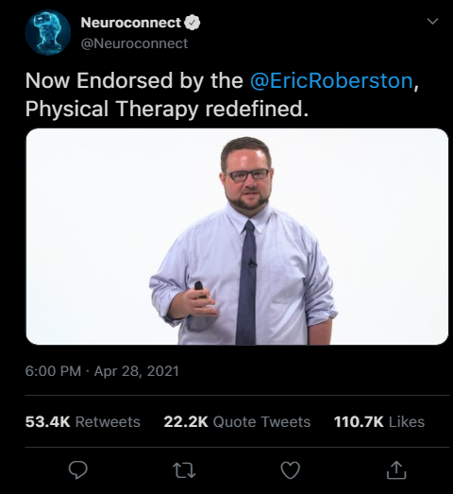
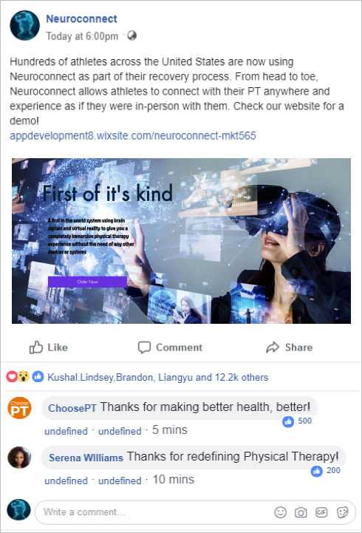
Twitter Facebook
Notes:
Kushal
We have created social media posts for Twitter and Facebook as well. Posting in Facebook groups specific to the recovery industry and using relevant hashtags on Twitter are effective ways to reach our target market.

Slide 14
Measuring Success through Achieving Objectives
KPIs
Return on Investment
Cost per acquisition
Sales trends
Growth in revenue
Net profit margin
Sales targets
Website traffic
Social Media Platform Analyzers
Notes:
Kushal
The best way to find out if this marketing plan as a whole reaches its goals and is successful, key performance indicators (KPIs) must be evaluated. KPIs are measurable values that we can utilize to see how effectively Neuroconnect is achieving its marketing objectives. The company wants to answer questions about whether or not the target market has been reached, if social media is increasing website traffic, if the website is encouraging inquiries, and if those factors contribute to sales.
The first KPI we want to look at is return on investment (ROI) for different marketing strategies. ROIs will allow us to understand if the costs spent on inbound and outbound marketing are less than the profit that the marketing turned. For inbound marketing, digital marketing analytics will help us determine ROI. Impressions on social media and the website and SEO factors show if there is an increase in our brand awareness and visibility. Followers, clicks, interactions on different social media platforms will show how engaged customers are with different kinds of posts and content. Platforms such as Twitter, LinkedIn, Facebook, Instagram, and Youtube all have their own analytics measuring tools that companies can use to see different engagement factors. Different integrated dashboards such as HootSuite and SproutSocial have marketing measurement tools that we could use to measure some KPIs.
For outbound marketing, we can measure response to emails. This will give us some insight on how effective this method is and if there is a high enough ROI to continue the newsletter and informative email. If each email brings a certain amount of unsubscribers, we will then know that that method is not where we should focus resources.
One of the biggest, and maybe the simplest measurement tools is looking at trends in sales. If our online presence grows, and sales increase, it is easy to make the connection that that is a reason as to why. We can track quote turnaround times and their impact on sales KPIs to see if the website and customer service is successful in inquiries becoming sales. Other financial KPIs such as growth in revenue, net profit margin, and cash flows are important to overall business goals and objectives.
However, specific to this marketing plan, we will pay most attention to cost per acquisition, cost per lead, and sales targets and growths. If in measuring these KPIs, we find that there is a positive ROI, we will know we are succeeding in the marketing department.

Slide 15
Stay relevant, stay successful
Notes:
Kushal
We will know where we are succeeding in the marketing department and where we are not from measuring KPIs. If we are not, we will know what changes need to be made and where exactly due to our efforts on creating a detailed strategy. We want Neuroconnect to be the first successful virtual reality physical recovery product of its kind and we believe that our strong marketing plan is an imperative first step.

Slide 16
Thanks!
Any questions?
Notes:
Kushal
Thank you for your time! If anyone has any doubts, we would be happy to help and answer your questions!

